Slide 1

Deep Learning
Neuron to Perceptron

Slide 2
References:
The Slides are prepared from the following major source:
“CS7105-Deep Learning” by Mitesh M. Khapra, IIT Madras.
http://www.cse.iitm.ac.in/~miteshk/CS7015_2018.html
NIT Rourkela
“Deep Learning: Neuron to Perceptron”

Slide 3
Biological Neurons
1
NIT Rourkela
“Deep Learning: Neuron to Perceptron”

Slide 4
Neuron
of a deep network is called an artificial
The most fundamental unit
y
neural
neuron
σ
The inspiration comes from (more specifically, from the brain)
biological neurons = neural cells processing units
biology
w₁ w₂ w₃
= neural
x1 x2 x3
Artificial Neuron
NIT Rourkela
“Deep Learning: Neuron to Perceptron”

Slide 5
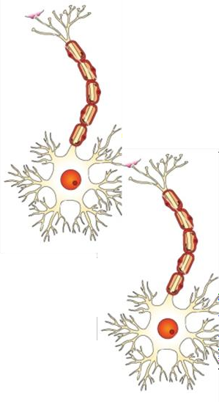
Biological neuron
Biological Neurons∗
∗Image adapted from
https://cdn.vectorstock.com/i/composite/12,25/neuron-c e l l - vector-81225.jpg
3
NIT Rourkela
“Deep Learning: Neuron to Perceptron”

Slide 6
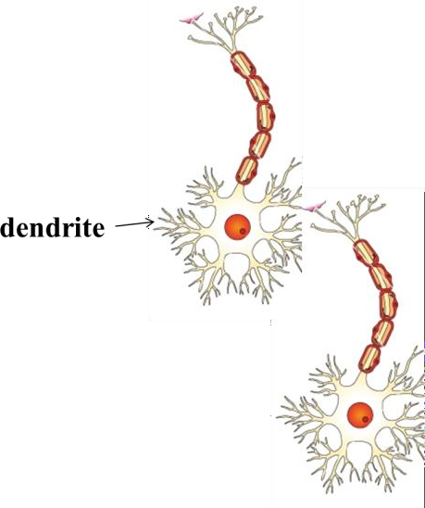
Biological neuron
dendrite:
neurons
receives signals from other
Biological Neurons∗
∗Image adapted from
https://cdn.vectorstock.com/i/composite/12,25/neuron-c e l l - vector-81225.jpg
3
NIT Rourkela
“Deep Learning: Neuron to Perceptron”

Slide 7
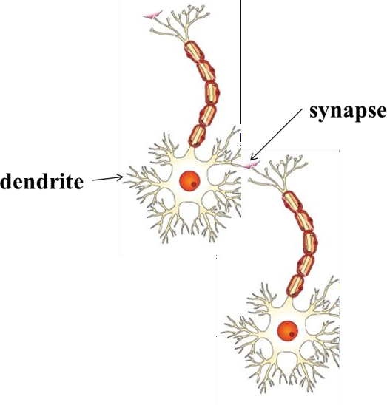
Biological neuron
dendrite: receives signals from other neurons
synapse: point of connection to other
neurons
Biological Neurons∗
∗Image adapted from
https://cdn.vectorstock.com/i/composite/12,25/neuron-c e l l - vector-81225.jpg
3
NIT Rourkela
“Deep Learning: Neuron to Perceptron”

Slide 8
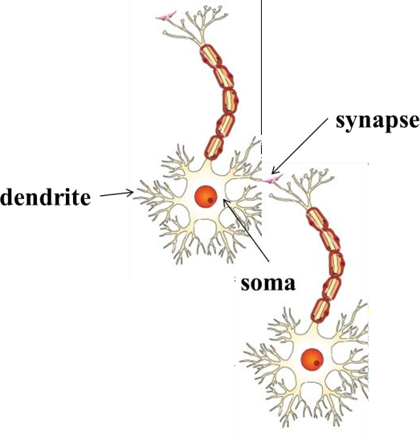
Biological neuron
dendrite: receives signals from other neurons
synapse: point of connection to other
neurons
soma: processes the information
Biological Neurons∗
∗Image adapted from
https://cdn.vectorstock.com/i/composite/12,25/neuron-c e l l - vector-81225.jpg
3
NIT Rourkela
“Deep Learning: Neuron to Perceptron”

Slide 9
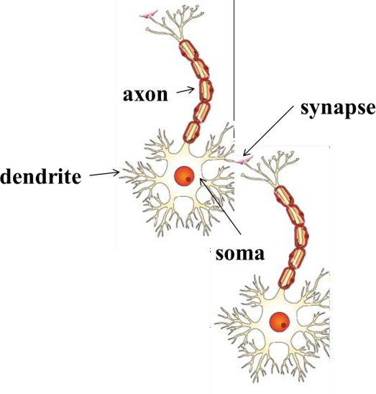
Biological neuron
dendrite: receives signals from other neurons
synapse: point of connection to other
neurons
soma: processes the information axon: transmits the output of this neuron
Biological Neurons∗
∗Image adapted from
https://cdn.vectorstock.com/i/composite/12,25/neuron-c e l l - vector-81225.jpg
3
NIT Rourkela
“Deep Learning: Neuron to Perceptron”

Slide 10
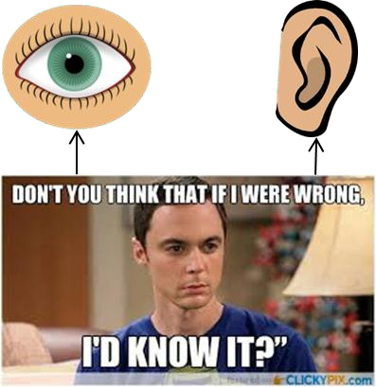
Biological neuron
Let us see a very cartoonish illustration of how a neuron works
Our sense organs interact with the out-
side world
4
NIT Rourkela
“Deep Learning: Neuron to Perceptron”

Slide 11
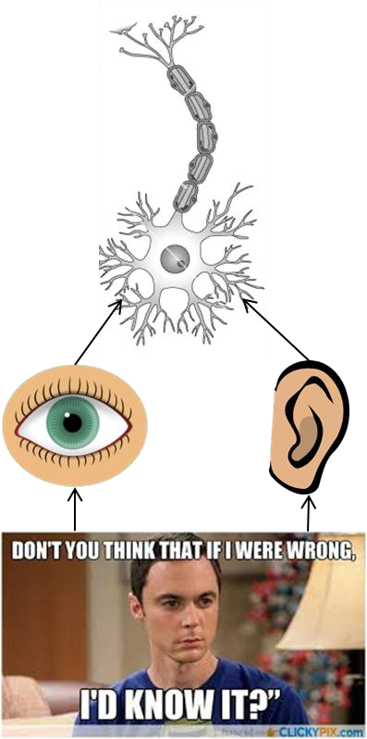
Biological neuron
Let us see a very cartoonish illustration of how a neuron works
Our sense organs interact with the out-
side world
They relay information to the neurons
4
NIT Rourkela
“Deep Learning: Neuron to Perceptron”

Slide 12
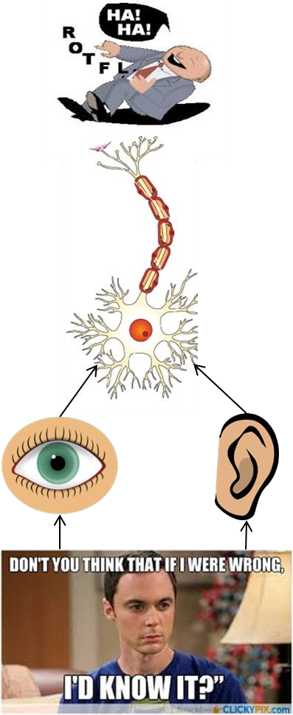
Biological neuron
Let us see a very cartoonish illustration of how a neuron works
Our sense organs interact with the out-
side world
They relay information to the neurons The neurons (may) get activated and pro-duces a response (laughter in this case)
4
NIT Rourkela
“Deep Learning: Neuron to Perceptron”

Slide 13
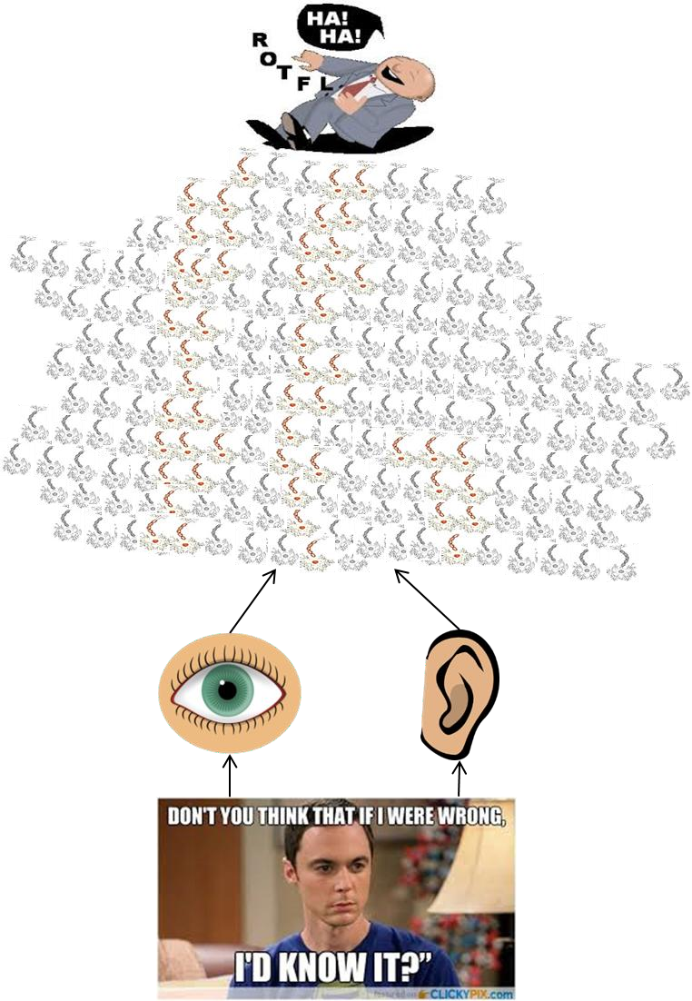
Biological neuron
Of course, in reality, there is a massively parallel
interconnected network of neurons
The sense organs relay information to the
lowest layer of neurons
Some of these neurons may fire (in red) in response to this information and in turn relay information to other neurons they are connected to
These neurons may also fire (again, in red) and the process continues, eventually resulting5 in a response (laughter in this case)
NIT Rourkela
“Deep Learning: Neuron to Perceptron”

Slide 14
Biological neuron
An average human brain has around 10¹¹ (100 bil-lion) neurons!
This massively parallel network also ensures that there is division of work
6
NIT Rourkela
“Deep Learning: Neuron to Perceptron”

Slide 15

Biological neuron
This massively parallel network also ensures that there is division of work
Each neuron may perform acertain role or respond
to a certain stimulus
Asimplified illustration
6
NIT Rourkela
“Deep Learning: Neuron to Perceptron”

Slide 16

Biological neuron
This massively parallel network also ensures that there is division of work
Each neuron may perform acertain role or respond
to a certain stimulus
Asimplified illustration
6
NIT Rourkela
“Deep Learning: Neuron to Perceptron”

Slide 17
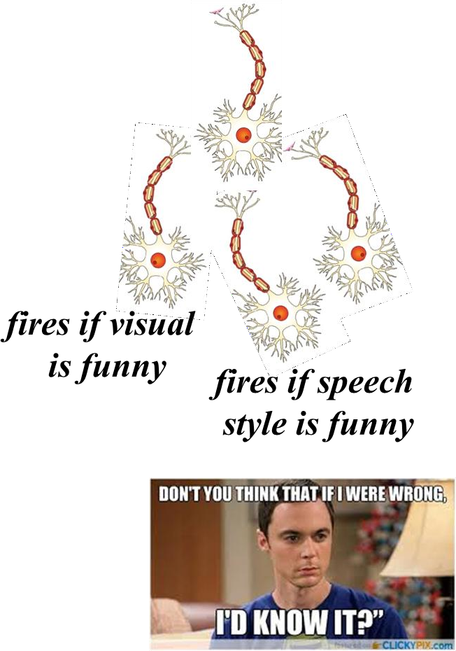
Biological neuron
This massively parallel network also ensures that there is division of work
Each neuron may perform acertain role or respond
to a certain stimulus
Asimplified illustration
6
NIT Rourkela
“Deep Learning: Neuron to Perceptron”

Slide 18

Biological neuron
This massively parallel network also ensures that there is division of work
Each neuron may perform acertain role or respond
to a certain stimulus
Asimplified illustration
6
NIT Rourkela
“Deep Learning: Neuron to Perceptron”

Slide 19
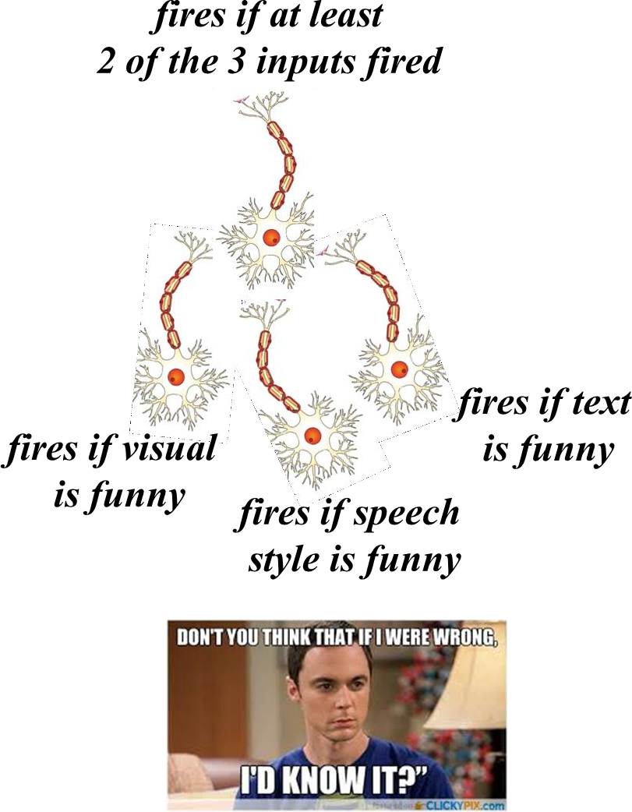
Biological neuron
This massively parallel network also ensures that there is division of work
Each neuron may perform acertain role or respond
to a certain stimulus
Asimplified illustration
6
NIT Rourkela
“Deep Learning: Neuron to Perceptron”

Slide 20
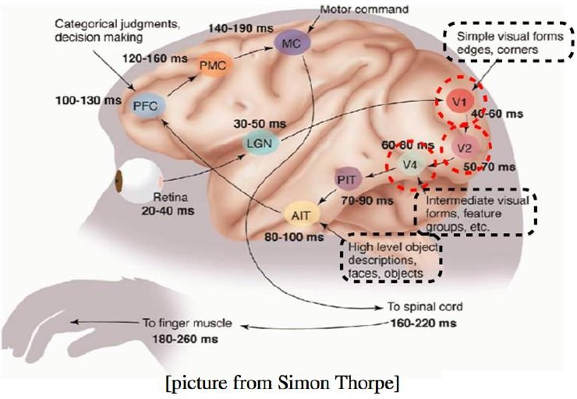
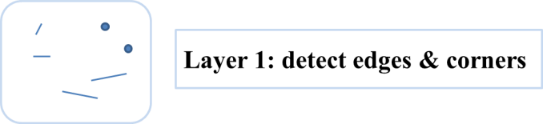
Biological neuron (hierarchy)
Sample illustration of hierarchical processing∗
∗Idea borrowed from Hugo Larochele’s lecture slides
8
NIT Rourkela
“Deep Learning: Neuron to Perceptron”

Slide 21
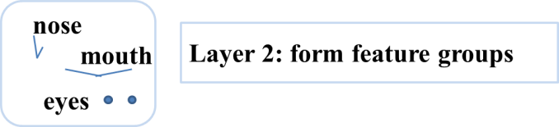
Biological neuron (hierarchy)
Sample illustration of hierarchical processing∗
∗Idea borrowed from Hugo Larochele’s lecture slides
8
NIT Rourkela
“Deep Learning: Neuron to Perceptron”

Slide 22
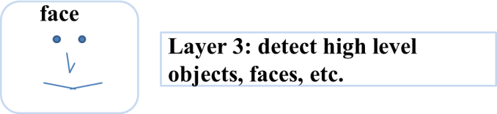
Biological neuron (hierarchy)
Sample illustration of hierarchical processing∗
∗Idea borrowed from Hugo Larochele’s lecture slides
8
NIT Rourkela
“Deep Learning: Neuron to Perceptron”

Slide 23
McCulloch Pitts Neuron
10
NIT Rourkela
“Deep Learning: Neuron to Perceptron”

Slide 24
McCulloch (neuroscientist) and Pitts (logician) proposed a highly simplified computational model of the neuron (1943)
x1 x2
.. ..
xn ∈ {0, 1}
11

Slide 25
y ∈ {0, 1}
McCulloch (neuroscientist) and Pitts (logician) proposed a highly simplified computational model of the neuron (1943)
g aggregates the inputs and the function f
takes a decision based on this aggregation
f
g
x1 x2
.. ..
xn ∈ {0, 1}
11

Slide 26
y ∈ {0, 1}
McCulloch (neuroscientist) and Pitts (logician) proposed a highly simplified computational model of the neuron (1943)
g aggregates the inputs and the function f
takes a decision based on this aggregation
f
g
n
g(x₁ , x ₂ , ..., x _{n} ) = g(x) = Σ x _{i}
i =1
x1 x2
.. ..
xn ∈ {0, 1}
11

Slide 27
y ∈ {0, 1}
McCulloch (neuroscientist) and Pitts (logician) proposed a highly simplified computational model of the neuron (1943)
g aggregates the inputs and the function f
takes a decision based on this aggregation
f
g
n
g(x₁ , x ₂ , ..., x _{n} ) = g(x) = Σ x _{i}
i =1
x1 x2
.. ..
xn ∈ {0, 1}
y = f (g(x)) = 1
= 0
if g(x) ≥ θ
if g(x) < θ
θ is ca led the thresholding parameter
11

Slide 28
Let us implement some
12

Slide 29

boolean functions using MP neuron ...
y ∈ {0, 1}
θ
x1 x2 x3
AMcCulloch Pitts unit
13
NIT Rourkela
“Deep Learning: Neuron to Perceptron”

Slide 30
boolean functions using MP neuron ...
y ∈ {0, 1} y ∈ {0, 1}
θ
x1 x2 x3
AMcCulloch Pitts unit
x1 x2 x3
AND function
13
NIT Rourkela
“Deep Learning: Neuron to Perceptron”

Slide 31
boolean functions using MP neuron ...
y ∈ {0, 1} y ∈ {0, 1}
θ
x1 x2 x3
AMcCulloch Pitts unit
3
x1 x2 x3
AND function
13
NIT Rourkela
“Deep Learning: Neuron to Perceptron”

Slide 32

boolean functions using MP neuron ...
y ∈ {0, 1} y ∈ {0, 1} y ∈ {0, 1}
θ
x1 x2 x3
AMcCulloch Pitts unit
3
x1 x2 x3
AND function
x1 x2 x3
OR function
13
NIT Rourkela
“Deep Learning: Neuron to Perceptron”

Slide 33
boolean functions using MP neuron ...
y ∈ {0, 1} y ∈ {0, 1} y ∈ {0, 1}
θ
x1 x2 x3
AMcCulloch Pitts unit
3
x1 x2 x3
AND function
1
x1 x2 x3
OR function
13
NIT Rourkela
“Deep Learning: Neuron to Perceptron”

Slide 34




boolean functions using MP neuron ...
y ∈ {0, 1}
y ∈ {0, 1} y ∈ {0, 1}
θ
x1 x2 x3
AMcCulloch Pitts unit
3
x1 x2 x3
AND function
1
x1 x2 x3
OR function
y ∈ {0, 1}
y ∈ {0, 1}
y ∈ {0, 1}
1
0
0
x1 x2
x1 x2
NOR function
x1
x₁ AND !x ∗
NOT function
2
∗circle at the end indicates inhibitory input: if any inhibitory input is 1 the output will be 0
13
NIT Rourkela
“Deep Learning: Neuron to Perceptron”

Slide 35

y ∈ {0, 1}
A single MP neuron splits the input points (4 points for 2 binary inputs) into two halves
1
x1 x2
OR function
x ₁ + x ₂ =
2
Σ
x _{i} ≥ 1
i =1
x2
Points lying on or above the line Σ ^{n} x i − θ = 0
(0, 1)
(1, 1)
i =1
and points lying below this line
x1 + x2 = θ = 1
x1
15
(0, 0)
(1, 0)

Slide 36
y ∈ {0, 1}
What if we have more than 2 inputs?
1
OR
x1 x2 x3
17

Slide 37
y ∈ {0, 1}
What if we have more than 2 inputs? Well, instead of aline we will have aplane For the OR function, we want a plane
such that the point (0,0,0) lies on one side and the remaining 7 points lie on the other side of the plane
1
OR
x1 x2 x3
x2
(0, 1, 0)
(1, 1, 0)
(0, 1, 1)
(1, 1, 1)x1 + x 2 + x 3
= θ = 1
(0, 0, 0)
(1, 0, 0) ^{x1}
(0, 0, 1)
(1, 0, 1)
x3
17

Slide 38
The story so far ...
Asingle McCu loch Pitts Neuron can be used to represent boolean functions which are linearly separable
18

Slide 39
The story ahead ...
What about non-boolean (say, real) inputs ?
20

Slide 40
The story ahead ...
What about non-boolean (say, real) inputs ?
Do we always need to hand code the threshold ?
20

Slide 41
The story ahead ...
What about non-boolean (say, real) inputs ?
Do we always need to hand code the threshold ?
Are all inputs equal ? What if we want to assign more weight (importance) to some inputs ?
20

Slide 42
The story ahead ...
What about non-boolean (say, real) inputs ?
Do we always need to hand code the threshold ?
Are all inputs equal ? What if we want to assign more weight (importance) to some inputs ?
What about functions which are not linearly separable ?
20

Slide 43
Perceptron
19
NIT Rourkela
“Deep Learning: Neuron to Perceptron”

Slide 44
Perceptron
y
Frank Rosenblatt, an American psychologist, pro-posed the classical perceptron model (1958)
w₁
w₂
.. ..
w_{n}
x1 x2
..
..
xn
21
NIT Rourkela
“Deep Learning: Neuron to Perceptron”

Slide 45
Perceptron
y
Frank Rosenblatt, an American psychologist, pro-posed the classical perceptron model (1958)
Main differences: Introduction of numerical weights for inputs and a mechanism for learning these weights
w₁
w₂
.. ..
w_{n}
x1 x2
..
..
xn
Inputs are no longer limited to boolean values Refined and carefully analyzed by Minsky and Pa-pert (1969) - their model is referred to as the per-ceptron model here
21
NIT Rourkela
“Deep Learning: Neuron to Perceptron”

Slide 46
Perceptron
y
n
Σ
i =1
n
Σ
i =1
y = 1 if
w_{i} ∗x _{i} ≥ θ
= 0 if
w_{i} ∗x _{i} < θ
w₁ w₂
.. ..
w_{n}
x1 x2
..
..
xn
22
NIT Rourkela
“Deep Learning: Neuron to Perceptron”

Slide 47
Perceptron
y
n
Σ
i =1
n
y = 1 if
w_{i} ∗x _{i} ≥ θ
= 0 if
Σ w_{i} ∗x _{i} < θ
i =1
w₁ w₂
.. ..
w_{n}
..
..
Rewriting the above,
x1 x2
xn
n
Σ
i =1
n
Σ
i =1
y = 1 if
w_{i} ∗x _{i} − θ ≥ 0
= 0 if
w_{i} ∗x _{i} − θ < 0
22
NIT Rourkela
“Deep Learning: Neuron to Perceptron”

Slide 48
Perceptron
y
n
Σ
i =1
n
y = 1 if
w_{i} ∗x _{i} ≥ θ
= 0 if
Σ w_{i} ∗x _{i} < θ
i =1
w₀ = −θ
w₁ w₂
.. ..
w_{n}
..
..
Rewriting the above,
x0 = 1
x1 x2
xn
Amore accepted convention, n | y = | 1 | if | n Σ | wi ∗x i − θ ≥ 0
y = 1 if Σ wi ∗x i ≥ 0 i =0 n | = | 0 | if | i =1 n Σ | w_{i} ∗x _{i} − θ < 0
= 0 if Σ w_{i} ∗x _{i} < 0 |  |  |  | i =1
i =0
where,
x0 = 1
and w0 = −θ
22
NIT Rourkela
“Deep Learning: Neuron to Perceptron”

Slide 49
Answer the following questions
Why are we trying to implement boolean functions? Why do we need weights ?
Why is w0 = −θ ca led the bias ?
23
NIT Rourkela
“Deep Learning: Neuron to Perceptron”

Slide 50
Why do we need weights ?
y
Consider the task of predicting whether we would like a movie or not
Suppose, we base our decision on 3 inputs (binary, for simplicity)
w₀ = −θ
w₁
w₂ w₃
x0 = 1
x1
x2
x3
Based on our past viewing experience (data), we may give a high weight to isDirectorNolan as compared to the other inputs
x1 = isActorDamon
x2 = isGenreThriller
x3 = isDirectorNolan
Specifically, even if the actor is not Matt Damon
and the genre is not thriller we would still want to cross the threshold θ by assigning a high weight to isDirectorNolan
NIT Rourkela
“Deep Learning: Neuron to Perceptron”

Slide 51
Why is w₀ = −θ called the bias ?
y
w0 is ca led the bias as it represents the prior (prejudice)
w₀ = −θ
w₁
w₂ w₃
x0 = 1
x1
x2
x3
x1 = isActorDamon x2 = isGenreThriller x3 = isDirectorNolan
24
NIT Rourkela
“Deep Learning: Neuron to Perceptron”

Slide 52
Why is w₀ = −θ called the bias ?
y
w0 is ca led the bias as it represents the prior (prejudice) Amovie buff may have a very low threshold and may watch any movie irrespective of the genre, actor, director [θ = 0]
On the other hand, a selective viewer may only watch thrillers starring Matt Damon and directed by Nolan [θ = 3]
The weights (w1, w2, ..., wn) and the bias (w0) will depend
on the data (viewer history in this case)
w₀ = −θ
w₁
w₂ w₃
x0 = 1
x1
x2
x3
x1 = isActorDamon x2 = isGenreThriller x3 = isDirectorNolan
24
NIT Rourkela
“Deep Learning: Neuron to Perceptron”

Slide 53
Perceptron vs McCulloch Pitts Neuron
McCulloch Pitts Neuron
A perceptron separates the input space into two
(assuming no inhibitory inputs) halves
n
y = 1 if Σ x _{i} ≥ 0
i =0
n
In other words, a single perceptron can only be used to implement linearly separable functions
Σ
i =0
= 0 if
x i < 0
Then what is the difference?
Perceptron
n
Σ
i =0
n
Σ
i =0
y = 1 if
w_{i} ∗x _{i} ≥ 0
= 0 if
w_{i} ∗x _{i} < 0
26
NIT Rourkela
“Deep Learning: Neuron to Perceptron”

Slide 54
Perceptron vs McCulloch Pitts Neuron
McCulloch Pitts Neuron
A perceptron separates the input space into two
(assuming no inhibitory inputs) _{halves}
n
y = 1 if Σ x _{i} ≥ 0
i =0
n
In other words, a single perceptron can only be used to implement linearly separable functions
Σ
i =0
= 0 if
x i < 0
Then what is the difference?
The weights (including threshold) can be learned and the inputs can be real valued
Perceptron
n
Σ
i =0
n
Σ
i =0
y = 1 if
w_{i} ∗x _{i} ≥ 0
perceptron weights)
learning
algorithm
(for
learning
= 0 if
w_{i} ∗x _{i} < 0
26
NIT Rourkela
“Deep Learning: Neuron to Perceptron”

Slide 55

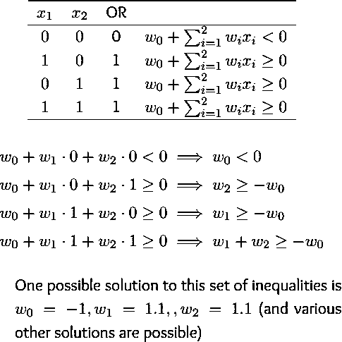
Learning the weights
27
NIT Rourkela
“Deep Learning: Neuron to Perceptron”

Slide 56
Errors and Error Surfaces
Let us fix the threshold (−w0 = 1) and try differ-ent values of w1, w2
x2
−1 + 1.1x1 + 1.1x2 = 0
(0, 1) (1, 1)
(0, 0)
(1, 0)
x1
29
NIT Rourkela
“Deep Learning: Neuron to Perceptron”

Slide 57
Errors and Error Surfaces
Let us fix the threshold (−w0 = 1) and try differ-ent values of w1, w2
Say, w1 = −1, w2 = −1
What is wrong with this line? We make an error
on 1 out of the 4 inputs
x2
−1 + 1.1x1 + 1.1x2 = 0
(0, 1) (1, 1)
(0, 0)
(1, 0)
x1
−1 + (−1)x1 + (−1)x2 = 0
29
NIT Rourkela
“Deep Learning: Neuron to Perceptron”

Slide 58
Errors and Error Surfaces
Let us fix the threshold (−w0 = 1) and try differ-ent values of w1, w2
Say, w1 = −1, w2 = −1
What is wrong with this line? We make an error
on 1 out of the 4 inputs
Lets try some more values of w1, w2 and note how many errors we make
x2
−1 + 1.1x1 + 1.1x2 = 0
(0, 1) (1, 1)
(0, 0)
(1, 0)
x1
−1 + (−1)x1 + (−1)x2 = 0
29
NIT Rourkela
“Deep Learning: Neuron to Perceptron”

Slide 59
Errors and Error Surfaces
Let us fix the threshold (−w0 =
ent values of w1, w2
Say, w1 = −1, w2 = −1
1) and try differ-
−1 + (0.45)x1 + (0.45)x2
= 0
x2
−1 + 1.1x1 + 1.1x2 = 0
(1, 1)
What is wrong with this line? We make an error
on 1 out of the 4 inputs
Lets try some more values of w1, w2 and note how many errors we make
(0, 1)
w1 w2 errors
(0, 0) (1, 0)
−1 + (1.5)x1 + (0)x2 = 0
x1
-1 -1 3
1.5 0 1
0.45 0.45 3
We are interested in those values of w0, w1, w2
which result in 0 error
−1 + (−1)x1 + (−1)x2 = 0
29
NIT Rourkela
“Deep Learning: Neuron to Perceptron”

Slide 60
Learning weights: movie review
y
Let us reconsider our problem of deciding whether to watch a movie or not
Suppose we are given a list of m movies and a la-bel (class) associated with each movie indicating whether the user liked this movie or not : binary decision
w₀ = −θ
w₁ w₂
.. ..
w_{n}
.. ..
Further, suppose we represent each movie with n
features (some boolean, some real valued)
We will assume that the data is linearly separable and we want a perceptron to learn how to make this decision
In other words, we want the perceptron to find the equation of this separating plane (or find the val-ues of w0, w1, w2, .., wm)
x0 = 1
x1 x2 xn
x1 = isActorDamon x2 = isGenreThriller
x3 = isDirectorNolan
x4 = imdbRating(scaled to 0 to 1)
...
...
xn = criticsRating(scaled to 0 to 1)
33
NIT Rourkela
“Deep Learning: Neuron to Perceptron”

Slide 61
Perceptron Learning Algorithm
31
NIT Rourkela
“Deep Learning: Neuron to Perceptron”

Slide 62
Algorithm: Perceptron Learning Algorithm
P ← inputs N ← inputs
with with
label 1;
label 0;
34

Slide 63
Algorithm: Perceptron Learning Algorithm
P ← inputs N ← inputs
with with
label 1;
label 0;
Initialize w randomly;
34

Slide 64
Algorithm: Perceptron Learning Algorithm
P ← inputs N ← inputs
with with
label 1;
label 0;
Initialize w randomly;
while !convergence do
end
//the algorithm converges when all the inputs
are classified correctly
34

Slide 65
Algorithm: Perceptron Learning Algorithm
P ← inputs N ← inputs
with with
label 1;
label 0;
Initialize w randomly;
while !convergence do
Pick random x ∈ P ∪ N ;
end
//the algorithm converges when all the inputs
are classified correctly
34

Slide 66
Algorithm: Perceptron Learning Algorithm
P ← inputs N ← inputs
with with
label 1;
label 0;
Initialize w randomly;
while !convergence do
Pick random x ∈ P ∪ N ;
if x ∈ P and
w = w + x ;
_{Σ} n
wi ∗x i
< 0 then
i =0
end
end
//the algorithm converges when all the inputs
are classified correctly
34

Slide 67
Algorithm: Perceptron Learning Algorithm
P ← inputs N ← inputs
with with
label 1;
label 0;
Initialize w randomly;
while !convergence do
Pick random x ∈ P ∪ N ;
if x ∈ P and
w = w + x ;
_{Σ} n
wi ∗x i
< 0 then
i =0
end
if x ∈ N and
w = w − x ;
_{Σ} n
wi ∗x i
≥ 0 then
i =0
end
end
//the algorithm converges when all the inputs
are classified correctly
34

Slide 68
Algorithm: Perceptron Learning Algorithm
Why would this work ?
To understand why this works we will have to get into a bit of Linear Algebra and a bit of geometry...
P ← inputs N ← inputs
with with
label 1;
label 0;
Initialize w randomly;
while !convergence do
Pick random x ∈ P ∪ N ;
if x ∈ P and
w = w + x ;
_{Σ} n
wi ∗x i
< 0 then
i =0
end
if x ∈ N and
w = w − x ;
_{Σ} n
wi ∗x i
≥ 0 then
i =0
end
end
//the algorithm converges when all the inputs are classified correctly
34

Slide 69
Consider two vectors w and x
35

Slide 70
Consider two vectors w and x
w = [w0, w1, w2, ..., wn]
x = [1, x1 , x2 , ..., xn]
35

Slide 71
Consider two vectors w and x
w = [w0, w1, w2, ..., wn]
x = [1, x1 , x2 , ..., xn]
n
w ·x = w ^{T} x = w_{i} ∗x _{i}
Σ
i =0
We can thus rewrite the perceptron rule as
y = 1 if w ^{T} x ≥ 0
= 0 if w ^{T} x < 0
35

Slide 72
Consider two vectors w and x
We are interested in finding the line w ^{T} x = 0 which divides the input space into two halves
w = [w0, w1, w2, ..., wn]
x = [1, x1 , x2 , ..., xn]
n
w ·x = w ^{T} x =
Σ
i =0
w_{i} ∗x _{i}
We can thus rewrite the perceptron rule as
y = 1 if w ^{T} x ≥ 0
= 0 if w ^{T} x < 0
35

Slide 73
Consider two vectors w and x
We are interested in finding the line w ^{T} x = 0 which divides the input space into two halves
Every point (x) on this line satisfies the equation w ^{T} x = 0
w = [w0, w1, w2, ..., wn]
x = [1, x1 , x2 , ..., xn]
n
Σ
i =0
T
w ·x = w x =
wi ∗xi
We can thus rewrite the perceptron rule as
y = 1 if w ^{T} x ≥ 0
= 0 if w ^{T} x < 0
35

Slide 74
Consider two vectors w and x
We are interested in finding the line w ^{T} x = 0 which divides the input space into two halves
Every point (x) on this line satisfies the equation w ^{T} x = 0
What can you tell about the angle (α) between w and any point (x) which lies on this line ?
w = [w0, w1, w2, ..., wn]
x = [1, x1 , x2 , ..., xn]
n
Σ
i =0
T
w ·x = w x =
wi ∗xi
We can thus rewrite the perceptron rule as
y = 1 if w ^{T} x ≥ 0
= 0 if w ^{T} x < 0
35

Slide 75
Consider two vectors w and x
We are interested in finding the line w ^{T} x = 0 which divides the input space into two halves
Every point (x) on this line satisfies the equation w ^{T} x = 0
What can you tell about the angle (α) between w and any point (x) which lies on this line ?
w = [w0, w1, w2, ..., wn]
x = [1, x1 , x2 , ..., xn]
n
Σ
i =0
T
w ·x = w x =
wi ∗xi
We can thus rewrite the perceptron rule as
Theangle is 90° (∵ cosα =
w^{T} x
||w||||x||
= 0)
y = 1 if w ^{T} x ≥ 0
= 0 if w ^{T} x < 0
35

Slide 76
Consider two vectors w and x
We are interested in finding the line w ^{T} x = 0 which divides the input space into two halves
Every point (x) on this line satisfies the equation w ^{T} x = 0
What can you tell about the angle (α) between w and any point (x) which lies on this line ?
w = [w0, w1, w2, ..., wn]
x = [1, x1 , x2 , ..., xn]
n
Σ
i =0
T
w ·x = w x =
wi ∗xi
We can thus rewrite the perceptron rule as
Theangle is 90° (∵ cosα =
w^{T} x
||w||||x||
= 0)
y = 1 if w ^{T} x ≥ 0
= 0 if w ^{T} x < 0
Since the vector w is perpendicular to every point on the line it is actually per-pendicular to the line itself
35

Slide 77
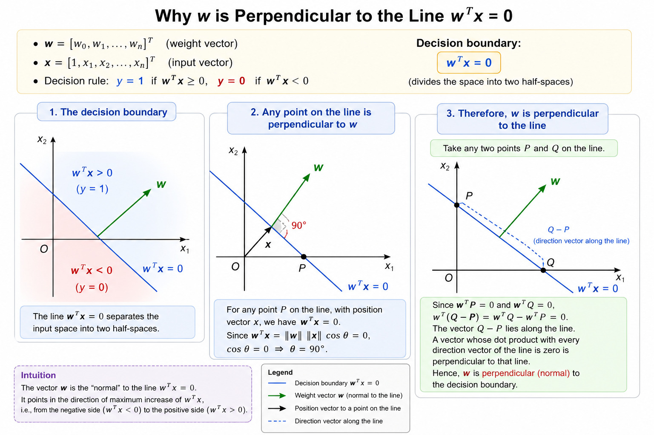

Slide 78
x2
w
w ^{T} x = 0
x1
36

Slide 79
Consider some points (vectors) which lie in the positive half space of this line (i.e., w ^{T} x ≥ 0)
x2
p2
w
w ^{T} x = 0
p1
p3
x1
36

Slide 80
Consider some points (vectors) which lie in the positive half space of this line (i.e., w ^{T} x ≥ 0)
What will be the angle between any such vector
and w ?
x2
p2
w
w ^{T} x = 0
p1
p
3
x1
36

Slide 81
Consider some points (vectors) which lie in the positive half space of this line (i.e., w ^{T} x ≥ 0)
What will be the angle between any such vector
and w ? Obviously, less than 90°
x2
p2
w
w ^{T} x = 0
p1
p
3
x1
36

Slide 82
Consider some points (vectors) which lie in the positive half space of this line (i.e., w ^{T} x ≥ 0)
What will be the angle between any such vector
and w ? Obviously, less than 90°
What about points (vectors) which lie in the neg-ative half space of this line (i.e., w ^{T} x < 0)
x2
p2
w
w ^{T} x = 0
p1
p
3
n
1
x1
n2 n3
36

Slide 83
Consider some points (vectors) which lie in the positive half space of this line (i.e., w ^{T} x ≥ 0)
What will be the angle between any such vector
and w ? Obviously, less than 90°
What about points (vectors) which lie in the neg-ative half space of this line (i.e., w ^{T} x < 0)
What will be the angle between any such vector
and w ?
x2
p2
w
w ^{T} x = 0
p1
p
3
n
1
x1
n2 n3
36

Slide 84
Consider some points (vectors) which lie in the positive half space of this line (i.e., w ^{T} x ≥ 0)
What will be the angle between any such vector
and w ? Obviously, less than 90°
What about points (vectors) which lie in the neg-ative half space of this line (i.e., w ^{T} x < 0)
What will be the angle between any such vector
and w ? Obviously, greater than 90°
x2
p2
w
w ^{T} x = 0
p1
p
3
n
1
x1
n2 n3
36

Slide 85
Consider some points (vectors) which lie in the positive half space of this line (i.e., w ^{T} x ≥ 0)
What will be the angle between any such vector
and w ? Obviously, less than 90°
What about points (vectors) which lie in the neg-ative half space of this line (i.e., w ^{T} x < 0)
What will be the angle between any such vector
and w ? Obviously, greater than 90°
Of course, this also follows from the formula
x2
p2
w
w ^{T} x = 0
p1
p
3
n
1
x1
(cosα =
w^{T} x
||w||||x||
)
n2 n3
36

Slide 86
Consider some points (vectors) which lie in the positive half space of this line (i.e., w ^{T} x ≥ 0)
What will be the angle between any such vector
and w ? Obviously, less than 90°
What about points (vectors) which lie in the neg-ative half space of this line (i.e., w ^{T} x < 0)
What will be the angle between any such vector
and w ? Obviously, greater than 90°
Of course, this also follows from the formula
x2
p2
w
w ^{T} x = 0
p1
p
3
n
1
x1
(cosα =
w^{T} x
||w||||x||
)
n2 n3
Keeping this picture in mind let us revisit the al-gorithm
36

Slide 87
Algorithm: Perceptron Learning Algorithm
P ← inputs N ← inputs
with with
label 1;
label 0;
Initialize w randomly;
while !convergence do
Pick random x ∈ P ∪ N ;
if x ∈ P and w.x < 0 then
w = w + x ;
end
if x ∈ N and w.x ≥ 0 then
w = w − x ;
end end
//the algorithm converges when all the inputs
are classified correctly w ^{T} x
37
cosα =

Slide 88
Algorithm: Perceptron Learning Algorithm
For x ∈ P if w.x < 0 then it means that the angle (α) between this x and the current w is greater than 90°
P ← inputs N ← inputs
with with
label 1;
label 0;
Initialize w randomly;
while !convergence do
Pick random x ∈ P ∪ N ;
if x ∈ P and w.x < 0 then
w = w + x ;
end
if x ∈ N and w.x ≥ 0 then
w = w − x ;
end end
//the algorithm converges when all the inputs
are classified correctly w ^{T} x
37
cosα =

Slide 89
Algorithm: Perceptron Learning Algorithm
For x ∈ P if w.x < 0 then it means that the angle (α) between this x and the current w is greater than 90° (but we want α to be less than 90°)
P ← inputs N ← inputs
with with
label 1;
label 0;
Initialize w randomly;
while !convergence do
Pick random x ∈ P ∪ N ;
if x ∈ P and w.x < 0 then
w = w + x ;
end
if x ∈ N and w.x ≥ 0 then
w = w − x ;
end end
//the algorithm converges when all the inputs
are classified correctly
w ^{T} x
37
cosα =

Slide 90
Algorithm: Perceptron Learning Algorithm
For x ∈ P if w.x < 0 then it means that the angle (α) between this x and the current w is greater than 90° (but we want α to be less than 90°)
What happens to the new angle (αnew) when wnew = w + x
P ← inputs N ← inputs
with with
label 1;
label 0;
Initialize w randomly;
while !convergence do
Pick random x ∈ P ∪ N ;
if x ∈ P and w. x < 0 then
w = w + x ;
end
if x ∈ N and w.x ≥ 0 then
w = w − x ;
end
end
//the algorithm converges when all the inputs are classified correctly
w ^{T} x
37
cosα =

Slide 91
Algorithm: Perceptron Learning Algorithm
For x ∈ P if w.x < 0 then it means that the angle (α) between this x and the current w is greater than 90° (but we want α to be less than 90°)
What happens to the new angle (αnew) when wnew = w + x
P ← inputs N ← inputs
with with
label 1;
label 0;
Initialize w randomly;
while !convergence do
Pick random x ∈ P ∪ N ;
if x ∈ P and w. x < 0 then
w = w + x ;
end
if x ∈ N and
w = w − x ;
cos(α ) ∝ w
T
x
new
new
w.x ≥ 0 then
end end
//the algorithm converges when all the inputs are classified correctly
w ^{T} x
37
cosα =

Slide 92
Algorithm: Perceptron Learning Algorithm
For x ∈ P if w.x < 0 then it means that the angle (α) between this x and the current w is greater than 90° (but we want α to be less than 90°)
What happens to the new angle (αnew) when wnew = w + x
P ← inputs N ← inputs
with with
label 1;
label 0;
Initialize w randomly;
while !convergence do
Pick random x ∈ P ∪ N ;
if x ∈ P and w. x < 0 then
w = w + x ;
end
if x ∈ N and
w = w − x ;
cos(α ) ∝ w
T
x
new
new
w.x ≥ 0 then
T
∝(w + x ) x
end end
//the algorithm converges when all the inputs are classified correctly
w ^{T} x
37
cosα =

Slide 93
Algorithm: Perceptron Learning Algorithm
For x ∈ P if w.x < 0 then it means that the angle (α) between this x and the current w is greater than 90° (but we want α to be less than 90°)
What happens to the new angle (αnew) when wnew = w + x
P ← inputs N ← inputs
with with
label 1;
label 0;
Initialize w randomly;
while !convergence do
Pick random x ∈ P ∪ N ;
if x ∈ P and w. x < 0 then
w = w + x ;
end
if x ∈ N and
w = w − x ;
cos(α ) ∝ w
T
x
new
new
w.x ≥ 0 then
T
∝(w + x ) x
T T
∝ w x + x x
end
end
//the algorithm converges when all the
inputs
are classified correctly w ^{T} x
37
cosα =

Slide 94
Algorithm: Perceptron Learning Algorithm
For x ∈ P if w.x < 0 then it means that the angle (α) between this x and the current w is greater than 90° (but we want α to be less than 90°)
What happens to the new angle (αnew) when wnew = w + x
P ← inputs N ← inputs
with with
label 1;
label 0;
Initialize w randomly;
while !convergence do
Pick random x ∈ P ∪ N ;
if x ∈ P and w. x < 0 then
w = w + x ;
end
if x ∈ N and
w = w − x ;
cos(α ) ∝ w
T
x
new
new
w.x ≥ 0 then
T
∝(w + x ) x
T T
∝ w x + x x
∝ cosα + x ^{T} x
end
end
//the algorithm converges when all the
inputs
are classified correctly w ^{T} x
37
cosα =

Slide 95
Algorithm: Perceptron Learning Algorithm
For x ∈ P if w.x < 0 then it means that the angle (α) between this x and the current w is greater than 90° (but we want α to be less than 90°)
What happens to the new angle (αnew) when wnew = w + x
P ← inputs N ← inputs
with with
label 1;
label 0;
Initialize w randomly;
while !convergence do
Pick random x ∈ P ∪ N ;
if x ∈ P and w. x < 0 then
w = w + x ;
end
if x ∈ N and
w = w − x ;
cos(α ) ∝ w
T
x
new
new
w.x ≥ 0 then
T
∝(w + x ) x
T T
∝ w x + x x
∝ cosα + x ^{T} x
cos(αnew) > cosα
37
end
end
//the algorithm converges when all the inputs
are classified correctly
w ^{T} x
cosα =

Slide 96
Algorithm: Perceptron Learning Algorithm
For x ∈ P if w.x < 0 then it means that the angle (α) between this x and the current w is greater than 90° (but we want α to be less than 90°)
What happens to the new angle (αnew) when wnew = w + x
P ← inputs N ← inputs
with with
label 1;
label 0;
Initialize w randomly;
while !convergence do
Pick random x ∈ P ∪ N ;
if x ∈ P and w. x < 0 then
w = w + x ;
end
if x ∈ N and
w = w − x ;
cos(α ) ∝ w
T
x
new
new
w.x ≥ 0 then
T
∝(w + x ) x
T T
∝ w x + x x
∝ cosα + x ^{T} x
cos(αnew) > cosα
Thus αnew will be less than α and
end
end
//the algorithm converges when all the inputs
are classified correctly
w ^{T} x
this is exactly what we want
37
cosα =

Slide 97
Algorithm: Perceptron Learning Algorithm
For x ∈ N if w.x ≥ 0 then it means that the angle (α) between this x and the current w is less than 90°
P ← inputs N ← inputs
with with
label 1;
label 0;
Initialize w randomly;
while !convergence do
Pick random x ∈ P ∪ N ;
if x ∈ P and w.x < 0 then
w = w + x ;
end
if x ∈ N and w.x ≥ 0 then
w = w − x ;
end end
//the algorithm converges when all the inputs are classified correctly
w ^{T} x
38
cosα =

Slide 98
Algorithm: Perceptron Learning Algorithm
For x ∈ N if w.x ≥ 0 then it means that the angle (α) between this x and the current w is less than 90° (but we want α to be greater than 90°)
What happens to the new angle (αnew) when wnew = w − x
T
cos(αnew) ∝ wnew x
P ← inputs N ← inputs
with with
label 1;
label 0;
Initialize w randomly;
while !convergence do
Pick random x ∈ P ∪ N ;
if x ∈ P and w. x < 0 then
w = w + x ;
end
if x ∈ N and
w = w − x ;
∝(w − x ) x
∝ w x − x x
∝ cosα − x ^{T} x
cos(αnew) < cosα
w.x ≥ 0 then
T
T T
end
end
//the algorithm converges when all the inputs
are classified correctly
Thusαnew will be greater than α and
w ^{T} x
this is exactly what we want
38
cosα =

Slide 99
We will now see this algorithm in action for a toy dataset
39

Slide 100
x2
We initialized w to a random value
p2
p1
p3
n1
x1
n2 n3
40

Slide 101
x2
We initialized w to a random value
We observe that currently, w ·x < 0 (∵ angle > 90°) for all the positive points and w ·x ≥ 0 (∵ angle < 90°) for all the negative points (the situ-ation is exactly oppsite of what we actually want it to be)
p2
p1
p
3
n1
x1
n2 n3
40

Slide 102
x2
We initialized w to a random value
We observe that currently, w ·x < 0 (∵ angle > 90°) for all the positive points and w ·x ≥ 0 (∵ angle < 90°) for all the negative points (the situ-ation is exactly oppsite of what we actually want it to be)
We now run the algorithm by randomly going over the points
p2
p1
p
3
n1
x1
n2 n3
40

Slide 103
x2
We initialized w to a random value
We observe that currently, w ·x < 0 (∵ angle > 90°) for all the positive points and w ·x ≥ 0 (∵ angle < 90°) for all the negative points (the situ-ation is exactly oppsite of what we actually want it to be)
We now run the algorithm by randomly going over the points
Randomly pick a point (say, p1), apply correction w = w + x ∵ w ·x < 0 (you can check the angle visually)
p2
p1
p
3
n1
x1
n2 n3
40

Slide 104
x2
We initialized w to a random value
We observe that currently, w ·x < 0 (∵ angle > 90°) for all the positive points and w ·x ≥ 0 (∵ angle < 90°) for all the negative points (the situ-ation is exactly oppsite of what we actually want it to be)
We now run the algorithm by randomly going over the points
Randomly pick a point (say, p1), apply correction w = w + x ∵ w ·x < 0 (you can check the angle visually)
p2
p1
p
3
n1
x1
n2 n3
40

Slide 105
x2
We initialized w to a random value
We observe that currently, w ·x < 0 (∵ angle > 90°) for all the positive points and w ·x ≥ 0 (∵ angle < 90°) for all the negative points (the situ-ation is exactly oppsite of what we actually want it to be)
We now run the algorithm by randomly going over the points
Randomly pick a point (say, p2), apply correction w = w + x ∵ w ·x < 0 (you can check the angle visually)
p2
p1
p
3
n1
x1
n2 n3
40

Slide 106
x2
We initialized w to a random value
We observe that currently, w ·x < 0 (∵ angle > 90°) for all the positive points and w ·x ≥ 0 (∵ angle < 90°) for all the negative points (the situ-ation is exactly oppsite of what we actually want it to be)
We now run the algorithm by randomly going over the points
Randomly pick a point (say, p2), apply correction w = w + x ∵ w ·x < 0 (you can check the angle visually)
p2
p1
p
3
n1
x1
n2 n3
40

Slide 107
x2
We initialized w to a random value
We observe that currently, w ·x < 0 (∵ angle > 90°) for all the positive points and w ·x ≥ 0 (∵ angle < 90°) for all the negative points (the situ-ation is exactly oppsite of what we actually want it to be)
We now run the algorithm by randomly going over the points
Randomly pick a point (say, n1), apply correction w = w −x ∵ w ·x ≥ 0 (you can check the angle visually)
p2
p1
p
3
n1
x1
n2 n3
40

Slide 108

x2
We initialized w to a random value
We observe that currently, w ·x < 0 (∵ angle > 90°) for all the positive points and w ·x ≥ 0 (∵ angle < 90°) for all the negative points (the situ-ation is exactly oppsite of what we actually want it to be)
We now run the algorithm by randomly going over the points
Randomly pick a point (say, n1), apply correction w = w −x ∵ w ·x ≥ 0 (you can check the angle visually)
p2
p1
p
3
n1
x1
n2 n3
40

Slide 109
x2
We initialized w to a random value
We observe that currently, w ·x < 0 (∵ angle > 90°) for all the positive points and w ·x ≥ 0 (∵ angle < 90°) for all the negative points (the situ-ation is exactly oppsite of what we actually want it to be)
We now run the algorithm by randomly going over the points
Randomly pick a point (say, n3), no correction needed ∵ w ·x < 0 (you can check the angle visually)
p2
p1
p
3
n1
x1
n2 n3
40

Slide 110

x2
We initialized w to a random value
We observe that currently, w ·x < 0 (∵ angle > 90°) for all the positive points and w ·x ≥ 0 (∵ angle < 90°) for all the negative points (the situ-ation is exactly oppsite of what we actually want it to be)
We now run the algorithm by randomly going over the points
Randomly pick a point (say, n3), no correction needed ∵ w ·x < 0 (you can check the angle visually)
p2
p1
p
3
n1
x1
n2 n3
40

Slide 111
x2
We initialized w to a random value
We observe that currently, w ·x < 0 (∵ angle > 90°) for all the positive points and w ·x ≥ 0 (∵ angle < 90°) for all the negative points (the situ-ation is exactly oppsite of what we actually want it to be)
We now run the algorithm by randomly going over the points
Randomly pick a point (say, n2), no correction needed ∵ w ·x < 0 (you can check the angle visually)
p2
p1
p
3
n1
x1
n2 n3
40

Slide 112

x2
We initialized w to a random value
We observe that currently, w ·x < 0 (∵ angle > 90°) for all the positive points and w ·x ≥ 0 (∵ angle < 90°) for all the negative points (the situ-ation is exactly oppsite of what we actually want it to be)
We now run the algorithm by randomly going over the points
Randomly pick a point (say, n2), no correction needed ∵ w ·x < 0 (you can check the angle visually)
p2
p1
p
3
n1
x1
n2 n3
40

Slide 113
x2
We initialized w to a random value
We observe that currently, w ·x < 0 (∵ angle > 90°) for all the positive points and w ·x ≥ 0 (∵ angle < 90°) for all the negative points (the situ-ation is exactly oppsite of what we actually want it to be)
We now run the algorithm by randomly going over the points
Randomly pick a point (say, p3), apply correction w = w + x ∵ w ·x < 0 (you can check the angle visually)
p2
p1
p
3
n1
x1
n2 n3
40

Slide 114
x2
We initialized w to a random value
We observe that currently, w ·x < 0 (∵ angle > 90°) for all the positive points and w ·x ≥ 0 (∵ angle < 90°) for all the negative points (the situ-ation is exactly oppsite of what we actually want it to be)
We now run the algorithm by randomly going over the points
Randomly pick a point (say, p3), apply correction w = w + x ∵ w ·x < 0 (you can check the angle visually)
p2
p1
p
3
n1
x1
n2 n3
40

Slide 115
x2
We initialized w to a random value
We observe that currently, w ·x < 0 (∵ angle > 90°) for all the positive points and w ·x ≥ 0 (∵ angle < 90°) for all the negative points (the situ-ation is exactly oppsite of what we actually want it to be)
We now run the algorithm by randomly going over the points
Randomly pick a point (say, p1), no correction needed ∵ w ·x ≥ 0 (you can check the angle visually)
p2
p1
p
3
n1
x1
n2 n3
40

Slide 116
x2
We initialized w to a random value
We observe that currently, w ·x < 0 (∵ angle > 90°) for all the positive points and w ·x ≥ 0 (∵ angle < 90°) for all the negative points (the situ-ation is exactly oppsite of what we actually want it to be)
We now run the algorithm by randomly going over the points
Randomly pick a point (say, p1), no correction needed ∵ w ·x ≥ 0 (you can check the angle visually)
p2
p1
p
3
n1
x1
n2 n3
40

Slide 117
x2
We initialized w to a random value
We observe that currently, w ·x < 0 (∵ angle > 90°) for all the positive points and w ·x ≥ 0 (∵ angle < 90°) for all the negative points (the situ-ation is exactly oppsite of what we actually want it to be)
We now run the algorithm by randomly going over the points
Randomly pick a point (say, p2), no correction needed ∵ w ·x ≥ 0 (you can check the angle visually)
p2
p1
p
3
n1
x1
n2 n3
40

Slide 118
x2
We initialized w to a random value
We observe that currently, w ·x < 0 (∵ angle > 90°) for all the positive points and w ·x ≥ 0 (∵ angle < 90°) for all the negative points (the situ-ation is exactly oppsite of what we actually want it to be)
We now run the algorithm by randomly going over the points
Randomly pick a point (say, p2), no correction needed ∵ w ·x ≥ 0 (you can check the angle visually)
p2
p1
p
3
n1
x1
n2 n3
40

Slide 119
x2
We initialized w to a random value
We observe that currently, w ·x < 0 (∵ angle > 90°) for all the positive points and w ·x ≥ 0 (∵ angle < 90°) for all the negative points (the situ-ation is exactly oppsite of what we actually want it to be)
We now run the algorithm by randomly going over the points
Randomly pick a point (say, n1), no correction needed ∵ w ·x < 0 (you can check the angle visually)
p2
p1
p
3
n1
x1
n2 n3
40

Slide 120
x2
We initialized w to a random value
We observe that currently, w ·x < 0 (∵ angle > 90°) for all the positive points and w ·x ≥ 0 (∵ angle < 90°) for all the negative points (the situ-ation is exactly oppsite of what we actually want it to be)
We now run the algorithm by randomly going over the points
Randomly pick a point (say, n1), no correction needed ∵ w ·x < 0 (you can check the angle visually)
p2
p1
p
3
n1
x1
n2 n3
40

Slide 121
x2
We initialized w to a random value
We observe that currently, w ·x < 0 (∵ angle > 90°) for all the positive points and w ·x ≥ 0 (∵ angle < 90°) for all the negative points (the situ-ation is exactly oppsite of what we actually want it to be)
We now run the algorithm by randomly going over the points
Randomly pick a point (say, n3), no correction needed ∵ w ·x < 0 (you can check the angle visually)
p2
p1
p
3
n1
x1
n2 n3
40

Slide 122
x2
We initialized w to a random value
We observe that currently, w ·x < 0 (∵ angle > 90°) for all the positive points and w ·x ≥ 0 (∵ angle < 90°) for all the negative points (the situ-ation is exactly oppsite of what we actually want it to be)
We now run the algorithm by randomly going over the points
Randomly pick a point (say, n3), no correction needed ∵ w ·x < 0 (you can check the angle visually)
p2
p1
p
3
n1
x1
n2 n3
40

Slide 123
x2
We initialized w to a random value
We observe that currently, w ·x < 0 (∵ angle > 90°) for all the positive points and w ·x ≥ 0 (∵ angle < 90°) for all the negative points (the situ-ation is exactly oppsite of what we actually want it to be)
We now run the algorithm by randomly going over the points
Randomly pick a point (say, n2), no correction needed ∵ w ·x < 0 (you can check the angle visually)
p2
p1
p
3
n1
x1
n2 n3
40

Slide 124
x2
We initialized w to a random value
We observe that currently, w ·x < 0 (∵ angle > 90°) for all the positive points and w ·x ≥ 0 (∵ angle < 90°) for all the negative points (the situ-ation is exactly oppsite of what we actually want it to be)
We now run the algorithm by randomly going over the points
Randomly pick a point (say, n2), no correction needed ∵ w ·x < 0 (you can check the angle visually)
p2
p1
p
3
n1
x1
n2 n3
40

Slide 125
x2
We initialized w to a random value
We observe that currently, w ·x < 0 (∵ angle > 90°) for all the positive points and w ·x ≥ 0 (∵ angle < 90°) for all the negative points (the situ-ation is exactly oppsite of what we actually want it to be)
We now run the algorithm by randomly going over the points
Randomly pick a point (say, p3), no correction needed ∵ w ·x ≥ 0 (you can check the angle visually)
p2
p1
p
3
n1
x1
n2 n3
40

Slide 126
x2
We initialized w to a random value
We observe that currently, w ·x < 0 (∵ angle > 90°) for all the positive points and w ·x ≥ 0 (∵ angle < 90°) for all the negative points (the situ-ation is exactly oppsite of what we actually want it to be)
We now run the algorithm by randomly going over the points
The algorithm has converged
p2
p1
p
3
n1
x1
n2 n3
40

Slide 127
Coming back to our questions ...
What about non-boolean (say, real) inputs?
Do we always need to hand code the threshold?
Are all inputs equal? What if we want to assign more weight (importance) to
some inputs?
What about functions which are not linearly separable ?

Slide 128
Coming back to our questions ...
What about non-boolean (say, real) inputs? Real valued inputs are allowed in per-ceptron
Do we always need to hand code the threshold?
Are all inputs equal? What if we want to assign more weight (importance) to
some inputs?
What about functions which are not linearly separable ?

Slide 129
Coming back to our questions ...
What about non-boolean (say, real) inputs? Real valued inputs are allowed in per-ceptron
Do we always need to hand code the threshold? No, we can learn the threshold Are all inputs equal? What if we want to assign more weight (importance) to some inputs?
What about functions which are not linearly separable ?

Slide 130
Coming back to our questions ...
What about non-boolean (say, real) inputs? Real valued inputs are allowed in per-ceptron
Do we always need to hand code the threshold? No, we can learn the threshold Are all inputs equal? What if we want to assign more weight (importance) to some inputs? Aperceptron allows weights to be assigned to inputs
What about functions which are not linearly separable ?

Slide 131
Coming back to our questions ...
What about non-boolean (say, real) inputs? Real valued inputs are allowed in per-ceptron
Do we always need to hand code the threshold? No, we can learn the threshold Are all inputs equal? What if we want to assign more weight (importance) to some inputs? Aperceptron allows weights to be assigned to inputs
What about functions which are not linearly separable ? Not possible with a single perceptron but we will see how to handle this ..

Slide 132
Non-Linearly Separable Boolean
Functions
NIT Rourkela
“Deep Learning: Neuron to Perceptron”

Slide 133
So what do we do about functions which are not linearly separable ?
Let us see one such simple boolean function first ?

Slide 134
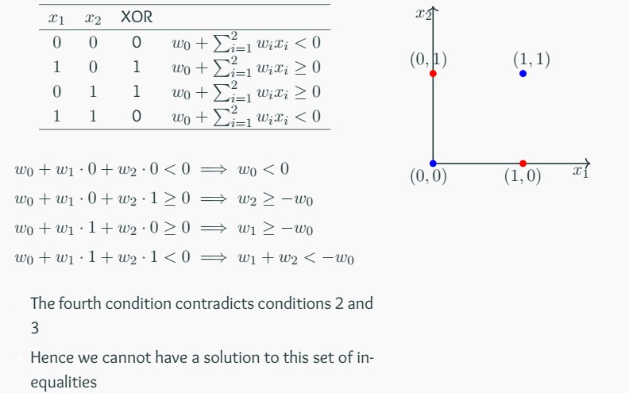
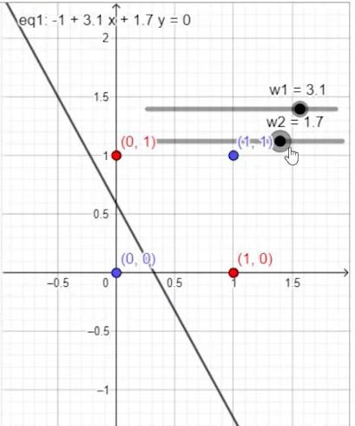

Slide 135
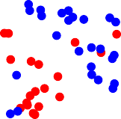
Most real world data is not linearly separable and will always contain some outliers
In fact, sometimes there may not be any outliers but still the data may not be linearly separable
While a single perceptron cannot deal with such data, we will show that a network of perceptrons can indeed deal with such data
_{oo}o o o o o_{oo}
o ₊ + + ₊ o
o
+ +
o
o ₊
+
o
o
o
o
+
+
+
o
o
+
o
o
+
+
o
o
+ +
o
o_{oo}
+ +
_{oo}o
ºo o oº

Slide 136
Before seeing how anetwork of perceptrons can deal with linearly inseparable data, we
will discuss boolean functions in some more detail ...

Slide 137
How many boolean functions can you design from 2 inputs ?

Slide 138
How many boolean functions can you design from 2 inputs ? Let us begin with some easy ones which you already know ..
x1 | x2 | f1
0 | 0 | 0
0 | 1 | 0
1 | 0 | 0
1 | 1 | 0

Slide 139
How many boolean functions can you design from 2 inputs ? Let us begin with some easy ones which you already know ..
x1 | x2 | f1 | f16
0 | 0 | 0 | 1
0 | 1 | 0 | 1
1 | 0 | 0 | 1
1 | 1 | 0 | 1

Slide 140
How many boolean functions can you design from 2 inputs ? Let us begin with some easy ones which you already know ..
x1 | x2 | f1 | f2 | f16
0 | 0 | 0 | 0 | 1
0 | 1 | 0 | 0 | 1
1 | 0 | 0 | 0 | 1
1 | 1 | 0 | 1 | 1

Slide 141
How many boolean functions can you design from 2 inputs ? Let us begin with some easy ones which you already know ..
x1 | x2 | f1 | f2 | f3 | f4 | f5 | f6 | f7 | f8 | f9 | f10 | f11 | f12 | f13 | f14 | f15 | f16
0 | 0 | 0 | 0 | 0 | 0 | 0 | 0 | 0 | 0 | 1 | 1 | 1 | 1 | 1 | 1 | 1 | 1
0 | 1 | 0 | 0 | 0 | 0 | 1 | 1 | 1 | 1 | 0 | 0 | 0 | 0 | 1 | 1 | 1 | 1
1 | 0 | 0 | 0 | 1 | 1 | 0 | 0 | 1 | 1 | 0 | 0 | 1 | 1 | 0 | 0 | 1 | 1
1 | 1 | 0 | 1 | 0 | 1 | 0 | 1 | 0 | 1 | 0 | 1 | 0 | 1 | 0 | 1 | 0 | 1

Slide 142
How many boolean functions can you design from 2 inputs ? Let us begin with some easy ones which you already know ..
x1 | x2 | f1 | f2 | f3 | f4 | f5 | f6 | f7 | f8 | f9 | f10 | f11 | f12 | f13 | f14 | f15 | f16
0 | 0 | 0 | 0 | 0 | 0 | 0 | 0 | 0 | 0 | 1 | 1 | 1 | 1 | 1 | 1 | 1 | 1
0 | 1 | 0 | 0 | 0 | 0 | 1 | 1 | 1 | 1 | 0 | 0 | 0 | 0 | 1 | 1 | 1 | 1
1 | 0 | 0 | 0 | 1 | 1 | 0 | 0 | 1 | 1 | 0 | 0 | 1 | 1 | 0 | 0 | 1 | 1
1 | 1 | 0 | 1 | 0 | 1 | 0 | 1 | 0 | 1 | 0 | 1 | 0 | 1 | 0 | 1 | 0 | 1
Of these, how many are linearly separable ?

Slide 143
How many boolean functions can you design from 2 inputs ? Let us begin with some easy ones which you already know ..
x1 | x2 | f1 | f2 | f3 | f4 | f5 | f6 | f7 | f8 | f9 | f10 | f11 | f12 | f13 | f14 | f15 | f16
0 | 0 | 0 | 0 | 0 | 0 | 0 | 0 | 0 | 0 | 1 | 1 | 1 | 1 | 1 | 1 | 1 | 1
0 | 1 | 0 | 0 | 0 | 0 | 1 | 1 | 1 | 1 | 0 | 0 | 0 | 0 | 1 | 1 | 1 | 1
1 | 0 | 0 | 0 | 1 | 1 | 0 | 0 | 1 | 1 | 0 | 0 | 1 | 1 | 0 | 0 | 1 | 1
1 | 1 | 0 | 1 | 0 | 1 | 0 | 1 | 0 | 1 | 0 | 1 | 0 | 1 | 0 | 1 | 0 | 1
Of these, how many are linearly separable ? (turns out all except XOR and !XOR)

Slide 144
How many boolean functions can you design from 2 inputs ? Let us begin with some easy ones which you already know ..
x1 | x2 | f1 | f2 | f3 | f4 | f5 | f6 | f7 | f8 | f9 | f10 | f11 | f12 | f13 | f14 | f15 | f16
0 | 0 | 0 | 0 | 0 | 0 | 0 | 0 | 0 | 0 | 1 | 1 | 1 | 1 | 1 | 1 | 1 | 1
0 | 1 | 0 | 0 | 0 | 0 | 1 | 1 | 1 | 1 | 0 | 0 | 0 | 0 | 1 | 1 | 1 | 1
1 | 0 | 0 | 0 | 1 | 1 | 0 | 0 | 1 | 1 | 0 | 0 | 1 | 1 | 0 | 0 | 1 | 1
1 | 1 | 0 | 1 | 0 | 1 | 0 | 1 | 0 | 1 | 0 | 1 | 0 | 1 | 0 | 1 | 0 | 1
Of these, how many are linearly separable ? (turns out all except XOR and !XOR)
In general, how many boolean functions can you have for n inputs ? 2^{2n}

Slide 145
How many boolean functions can you design from 2 inputs ? Let us begin with some easy ones which you already know ..
x1 | x2 | f1 | f2 | f3 | f4 | f5 | f6 | f7 | f8 | f9 | f10 | f11 | f12 | f13 | f14 | f15 | f16
0 | 0 | 0 | 0 | 0 | 0 | 0 | 0 | 0 | 0 | 1 | 1 | 1 | 1 | 1 | 1 | 1 | 1
0 | 1 | 0 | 0 | 0 | 0 | 1 | 1 | 1 | 1 | 0 | 0 | 0 | 0 | 1 | 1 | 1 | 1
1 | 0 | 0 | 0 | 1 | 1 | 0 | 0 | 1 | 1 | 0 | 0 | 1 | 1 | 0 | 0 | 1 | 1
1 | 1 | 0 | 1 | 0 | 1 | 0 | 1 | 0 | 1 | 0 | 1 | 0 | 1 | 0 | 1 | 0 | 1
Of these, how many are linearly separable ? (turns out all except XOR and !XOR)
In general, how many boolean functions can you have for n inputs ? 2^{2n}
How many of these 2^{2n} functions are not linearly separable ?
For the time being, it suffices to know that at least some of these may not be linearly inseparable

Slide 146
Module 2.8: Representation Power of a Network of Perceptrons

Slide 147
For this discussion, we will assume True = +1 and False = -1
We consider 2 inputs and 4 perceptrons
x₁
x₂

Slide 148
For this discussion, we will assume True = +1 and False = -1
We consider 2 inputs and 4 perceptrons Each input is connected to all the 4 per-ceptrons with specific weights
x₁
red edge indicates w = -1 blue edge indicates w = +1
x₂

Slide 149
For this discussion, we will assume True = +1 and False = -1
We consider 2 inputs and 4 perceptrons Each input is connected to all the 4 per-ceptrons with specific weights
The bias (w0) of each perceptron is -2 (i.e., each perceptron will fire only if the weighted sum of its input is ≥ 2)
bias = - 2
x₁
red edge indicates w = -1 blue edge indicates w = +1
x₂

Slide 150
For this discussion, we will assume True = +1 and False = -1
We consider 2 inputs and 4 perceptrons Each input is connected to all the 4 per-ceptrons with specific weights
The bias (w0) of each perceptron is -2 (i.e., each perceptron will fire only if the weighted sum of its input is ≥ 2)
Each of these perceptrons is connected to an output perceptron by weights (which need to be learned)
w₁
w₂ w₃ w₄
bias = - 2
x₁
red edge indicates w = -1 blue edge indicates w = +1
x₂

Slide 151
For this discussion, we will assume True = +1 and False = -1
We consider 2 inputs and 4 perceptrons Each input is connected to all the 4 per-ceptrons with specific weights
The bias (w0) of each perceptron is -2 (i.e., each perceptron will fire only if the weighted sum of its input is ≥ 2)
Each of these perceptrons is connected to
y
w₁
w₂ w₃ w₄
bias = - 2
x₁
red edge indicates w = -1 blue edge indicates w = +1
an output perceptron by weights (which
need to be learned)
The output of this perceptron (y) is the out-put of this network
x₂

Slide 152
Terminology:
This network contains 3 layers
The layer containing the inputs (x1, x2) is ca led the input layer
Themiddle layer containing the 4 perceptrons
is ca led the hidden layer
The final layer containing one output neuron is ca led the output layer
y
w₁
w₂ w₃ w₄
bias = - 2
x₁
red edge indicates w = -1 blue edge indicates w = +1
x₂

Slide 153
Terminology:
This network contains 3 layers
The layer containing the inputs (x1, x2) is ca led the input layer
Themiddle layer containing the 4 perceptrons
is ca led the hidden layer
The final layer containing one output neuron is ca led the output layer
The outputs of the 4 perceptrons in the hidden layer are denoted by h1, h2, h3, h4
The red and blue edges are called layer 1 weights
w₁ , w₂ , w₃ , w₄ are ca led layer 2 weights
y
w₁
w₂ w₃ w₄
h₂ h₃
h₁
h₄
bias = - 2
x₁
red edge indicates w = -1 blue edge indicates w = +1
x₂

Slide 154
We claim that this network can be used to im-plement any boolean function (linearly separable or not) !
y
w₁
w₂ w₃ w₄
h₂ h₃
h₁
h₄
bias = - 2
x₁
red edge indicates w = -1 blue edge indicates w = +1
x₂

Slide 155
We claim that this network can be used to im-
plement any boolean function (linearly separable or not) !
In other words, we can find w1, w2, w3, w4
such that the truth table of any boolean func-
y
w₁
w₂ w₃ w₄
h₂ h₃
tion can be represented by this network
h₁
h₄
bias = - 2
x₁
red edge indicates w = -1 blue edge indicates w = +1
x₂

Slide 156
We claim that this network can be used to im-
plement any boolean function (linearly
y
separable or not) !
In other words, we can find w1, w2, w3, w4
such that the truth table of any boolean func-
w₁
w₂ w₃ w₄
h₂ h₃
tion can be represented by this network Astonishing claim! Well, not really, if you un-derstand what is going on
h₁
h₄
bias = - 2
x₁
red edge indicates w = -1 blue edge indicates w = +1
x₂

Slide 157
We claim that this network can be used to im-
plement any boolean function (linearly
y
separable or not) !
In other words, we can find w1, w2, w3, w4
such that the truth table of any boolean func-
w₁
w₂ w₃ w₄
h₂ h₃
tion can be represented by this network Astonishing claim! Well, not rea ly, if you un-derstand what is going on
Each perceptron in the middle layer fires only for a specific input (and no two perceptrons fire for the same input)
the first perceptron fires for {-1,-1}
h₁
-1,-1
h₄
bias = - 2
x₁
red edge indicates w = -1 blue edge indicates w = +1
x₂

Slide 158
We claim that this network can be used to im-
plement any boolean function (linearly
y
separable or not) !
In other words, we can find w1, w2, w3, w4
such that the truth table of any boolean func-
w₁
w₂ w₃ w₄
h₂ h₃
-1,1
tion can be represented by this network Astonishing claim! Well, not rea ly, if you un-derstand what is going on
Each perceptron in the middle layer fires only for a specific input (and no two perceptrons fire for the same input)
the second perceptron fires for {-1,1}
h₁
-1,-1
h₄
bias = - 2
x₁
red edge indicates w = -1 blue edge indicates w = +1
x₂

Slide 159
We claim that this network can be used to im-
plement any boolean function (linearly
y
separable or not) !
In other words, we can find w1, w2, w3, w4
such that the truth table of any boolean func-
w₁
w₂ w₃ w₄
h₂ h₃
-1,1 1,-1
tion can be represented by this network Astonishing claim! Well, not rea ly, if you un-derstand what is going on
Each perceptron in the middle layer fires only for a specific input (and no two perceptrons fire for the same input)
the third perceptron fires for {1,-1}
h₁
-1,-1
h₄
bias = - 2
x₁
red edge indicates w = -1 blue edge indicates w = +1
x₂

Slide 160
We claim that this network can be used to im-
plement any boolean function (linearly
y
separable or not) !
In other words, we can find w1, w2, w3, w4
such that the truth table of any boolean func-
w₁
w₂ w₃ w₄
h₂ h₃
-1,1 1,-1
tion can be represented by this network Astonishing claim! Well, not rea ly, if you un-derstand what is going on
Each perceptron in the middle layer fires only for a specific input (and no two perceptrons fire for the same input)
the fourth perceptron fires for {1,1}
h₁
-1,-1
h₄
1,1
bias = - 2
x₁
red edge indicates w = -1 blue edge indicates w = +1
x₂

Slide 161
We claim that this network can be used to im-
plement any boolean function (linearly
y
separable or not) !
In other words, we can find w1, w2, w3, w4
such that the truth table of any boolean func-
w₁
w₂ w₃ w₄
h₂ h₃
-1,1 1,-1
tion can be represented by this network Astonishing claim! Well, not rea ly, if you un-derstand what is going on
Each perceptron in the middle layer fires only for a specific input (and no two perceptrons fire for the same input)
Let us see why this network works by taking an example of the XOR function
h₁
-1,-1
h₄
1,1
bias = - 2
x₁
red edge indicates w = -1 blue edge indicates w = +1
x₂

Slide 162
Let w0 be the bias output of the neuron (i.e.,
it will fire if
4
wihi ≥ w0)
Σi =1
y
w₁
w₂ w₃ w₄
h₂ h₃
-1,1 1,-1
h₁
-1,-1
h₄
1,1
bias = - 2
x₁
red edge indicates w = -1 blue edge indicates w = +1
x₂

Slide 163
Let w0 be the bias output of the neuron (i.e.,
it will fire if
_{Σ} 4
wihi ≥ w0)
i =1
y
x₁ x₂ X O R h₁ h₂ h₃ h₄
_{Σ} 4
w_{i}h_{i}
i =1
0 0
0
1 0 0 0
w₁
w₁
w₂ w₃ w₄
h₂ h₃
-1,1 1,-1
h₁
-1,-1
h₄
1,1
bias = - 2
x₁
red edge indicates w = -1 blue edge indicates w = +1
x₂

Slide 164
Let w0 be the bias output of the neuron (i.e.,
it will fire if
_{Σ} 4
wihi ≥ w0)
i =1
y
x₁ 0 | x₂ 0 | XOR 0 | h₁ 1 | h₂ 0 | h₃ 0 | h₄ 0 | ^{Σ 4} w h i i i = 1 w₁
0 | 1 | 1 | 0 | 1 | 0 | 0 | w₂
w₁
w₂ w₃ w₄
h₂ h₃
-1,1 1,-1
h₁
-1,-1
h₄
1,1
bias = - 2
x₁
red edge indicates w = -1 blue edge indicates w = +1
x₂

Slide 165
Let w0 be the bias output of the neuron (i.e.,
it will fire if
_{Σ} 4
wihi ≥ w0)
i =1
y
x₁ 0 | x₂ 0 | XOR 0 | h₁ 1 | h₂ 0 | h₃ 0 | h₄ 0 | ^{Σ 4} w h i i i = 1 w₁
0 | 1 | 1 | 0 | 1 | 0 | 0 | w₂
w₁
w₂ w₃ w₄
h₂ h₃
-1,1 1,-1
h₁
-1,-1
h₄
1,1
w
1 0
1
0 0 1 0
3
bias = - 2
x₁
red edge indicates w = -1 blue edge indicates w = +1
x₂

Slide 166
Let w0 be the bias output of the neuron (i.e.,
it will fire if
_{Σ} 4
wihi ≥ w0)
i =1
y
x₁ 0 | x₂ 0 | XOR 0 | h₁ 1 | h₂ 0 | h₃ 0 | h₄ 0 | ^{Σ 4} w h i i i = 1 w₁
0 | 1 | 1 | 0 | 1 | 0 | 0 | w₂
w₁
w₂ w₃ w₄
h₂ h₃
-1,1 1,-1
h₁
-1,-1
h₄
1,1
1 0 1 0 0 1 0 w
3
1 1 0 0 0 0 1 w₄
bias = - 2
x₁
red edge indicates w = -1 blue edge indicates w = +1
x₂

Slide 167
Let w0 be the bias output of the neuron (i.e.,
it will fire if
_{Σ} 4
wihi ≥ w0)
i =1
y
x₁ 0 | x₂ 0 | XOR 0 | h₁ 1 | h₂ 0 | h₃ 0 | h₄ 0 | ^{Σ 4} w h i i i = 1 w₁
0 | 1 | 1 | 0 | 1 | 0 | 0 | w₂
w₁
w₂ w₃ w₄
h₂ h₃
-1,1 1,-1
h₁
-1,-1
h₄
1,1
1 0 1 0 0 1 0 w
3
1 1 0 0 0 0 1 w₄
This results in the following four conditions to implement XOR: w₁ < w₀, w₂ ≥ w₀, w₃ ≥ w₀, w₄ < w₀
bias = - 2
x₁
red edge indicates w = -1 blue edge indicates w = +1
x₂

Slide 168
Let w0 be the bias output of the neuron (i.e.,
it will fire if Σ ⁴
i =1
wihi ≥ w0)
y
x₁ 0 | x₂ 0 | XOR 0 | h₁ 1 | h₂ 0 | h₃ 0 | h₄ 0 | ^{Σ 4} w h i i i = 1 w₁
0 | 1 | 1 | 0 | 1 | 0 | 0 | w₂
w₁
w₂ w₃ w₄
h₂ h₃
-1,1 1,-1
h₁
-1,-1
h₄
1,1
1 0 1 0 0 1 0 w
3
1 1 0 0 0 0 1 w₄
This results in the following four conditions to
bias = - 2
implement XOR: w₁ w₀, w₄ < w₀
Unlike before, there are no contradictions now and the system of inequalities can be satisfied
< w₀, w₂ ≥ w₀, w₃ ≥
x₁
red edge indicates w = -1 blue edge indicates w = +1
x₂

Slide 169
Let w0 be the bias output of the neuron (i.e.,
it will fire if
_{Σ} 4
wihi ≥ w0)
i =1
y
x₁ 0 | x₂ 0 | XOR 0 | h₁ 1 | h₂ 0 | h₃ 0 | h₄ 0 | ^{Σ 4} w h i i i = 1 w₁
0 | 1 | 1 | 0 | 1 | 0 | 0 | w₂
w₁
w₂ w₃ w₄
h₂ h₃
-1,1 1,-1
h₁
-1,-1
h₄
1,1
1 0 1 0 0 1 0 w
3
1 1 0 0 0 0 1 w₄
This results in the following four conditions to
bias = - 2
implement XOR: w₁ w₀, w₄ < w₀
Unlike before, there are no contradictions now and the system of inequalities can be satisfied
Essentia ly each w_{i} is now responsible for one of the 4 possible inputs and can be adjusted to get the desired output for that input
< w₀, w₂ ≥ w₀, w₃ ≥
x₁
red edge indicates w = -1 blue edge indicates w = +1
x₂

Slide 170
It should be clear that the same network can be used to represent the remaining 15 boolean functions also
y
w₁
w₂ w₃ w₄
h₂ h₃
-1,1 1,-1
h₁
-1,-1
h₄
1,1
bias = - 2
x₁
red edge indicates w = -1 blue edge indicates w = +1
x₂

Slide 171
It should be clear that the same network can be used to represent the remaining 15 boolean functions also
y
Each boolean function will result in a dif-ferent set of non-contradicting inequalities which can be satisfied by appropriately set-
w₁
w₂ w₃ w₄
h₂ h₃
-1,1 1,-1
h₁
-1,-1
h₄
1,1
ting w , w , w , w
1 2 3 4
bias = - 2
x₁
red edge indicates w = -1 blue edge indicates w = +1
x₂

Slide 172
What if we have more than 3 inputs ?

Slide 173
Again each of the 8 perceptorns will fire only for one of the 8 inputs
Each of the 8 weights in the second layer is responsible for one of the 8 inputs and can be adjusted to produce the desired output for that input
y
w₁ w₂ w₃ w₄
w₅ w₆ w₇ w₈
bias = - 3
x₁
x₂
x₃

Slide 174
What if we have n inputs?

Slide 175
Theorem
Any boolean function of n inputs can be represented exactly by a network of perceptrons containing 1 hidden layer with 2^{n} perceptrons and one output layer containing 1 perceptron
Proof (informal:) We just saw how to construct such a network
Note: Anetwork of 2^{n} + 1 perceptrons is not necessary but sufficient. For example, we already saw how to represent AND function with just 1 perceptron

Slide 176
Theorem
Any boolean function of n inputs can be represented exactly by a network of perceptrons containing 1 hidden layer with 2^{n} perceptrons and one output layer containing 1 perceptron
Proof (informal:) We just saw how to construct such a network
Note: Anetwork of 2^{n} + 1 perceptrons is not necessary but sufficient. For example, we already saw how to represent AND function with just 1 perceptron
Catch: As n increases the number of perceptrons in the hidden layers obviously increases exponentially

Slide 177
The story so far ...
Networks of the form that we just saw (containing, an input, output and one or more hidden layers) are ca led Multilayer Perceptrons (MLP, in short)
More appropriate terminology would be“Multilayered Network of Perceptrons” but MLP is the more commonly used name
The theorem that we just saw gives us the representation power of a MLP with a single hidden layer

